Slide 1




Web Services, SOA and REST
Services, Clients, SOAP, WSDL, XML, HTTP, REST, RESTful Services, JSON
Web Services & Cloud
SoftUni Team
Technical Trainers
Software University
http://softuni.bg

Slide 2

Table of Contents
Distributed Apps, Web Services and Service-Oriented Architecture (SOA)
Enterprise Web Service Infrastructure, Standards and Protocols
SOAP, WSDL, HTTP, XML, WS-*, …
The HTTP Protocol
RESTful Web Services
Representational State Transfer (REST)
CRUD Operations and HTTP Methods
Postman – REST Client

Slide 3




Distributed Apps, Web Services and SOA

Slide 4
Distributed Applications
Most modern applications are distributed
Several components interact with each other
Distributed application models
"Client-Server" model – persistent socket / WebSocket connection
"Distributed Objects" model – client an server objects
DCOM, CORBA, Java RMI, .NET Remoting, …
Outdated, not used in modern apps
"Web Services" / "RESTful Web Services" model
RESTful (HTTP, REST, JSON) and heavy services (SOAP, WSDL, XML)

Slide 5

Services: Real World and Software
In the real world a "service" is:
A piece of work performed by a service provider
Takes some input and produces some desired results
E.g. a supermarket: pay some money and get some food
Has quality characteristics (price, execution time, constraints, etc.)
In the software world a "service"
Takes some input, performs some work, produces some output
Request-response model: client requests, server responses

Slide 6

Web Services and Clients
A "web service" is:
Software service that communicates over standard Web protocols
Classical (heavyweight) services use SOAP, WSDL, XML, WS-*
Lightweight (RESTful) services use HTTP, REST and JSON
A "client" (consumer) uses the services
Requests something to be performed
Gets the desired result
Or gets an error

Slide 7
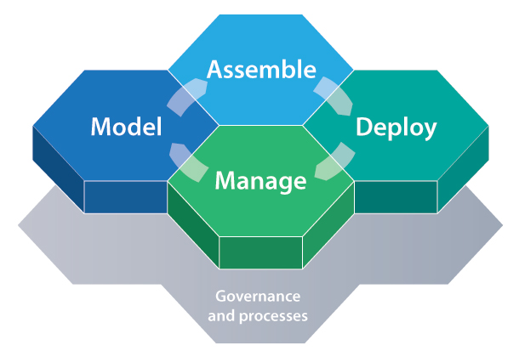
What is Service-Oriented Architecture (SOA)?
SOA (Service-Oriented Architecture) is an architectural concept for development of software systems
Using reusable building blocks (components) called "services"
SOA == decouple the monolithic software to reusable services
Services in SOA are:
Autonomous, stateless business functions
Accept requests and return responses
Use well-defined, standard interface (standard protocols)

Slide 8


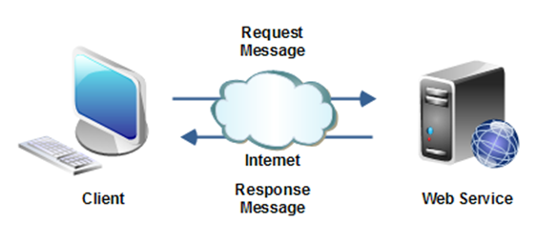
SOA Services
Autonomous
Each service operates autonomously
Without any awareness that other services exist
Stateless
Do not remember a durable state between requests
Can store state in a database and reference it by ID
Easy to scale → just add more nodes
Request-response model
Client asks, server returns an answer
Server never sends requests to the client

Slide 9
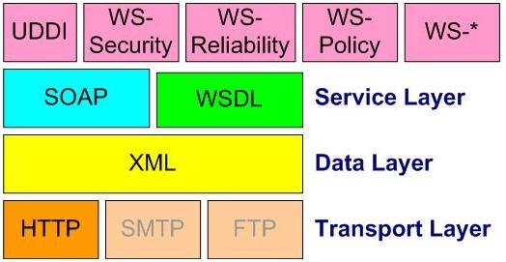
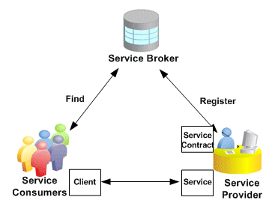
SOA Services (2)
Communication through standard protocols
HTTP, FTP, SMTP, RPC, MSMQ, ...
JSON, XML, SOAP, RSS, WS-*, ...
Platform independent
Independent of OS, platforms, languages, frameworks, …
Discoverable
Service registries and brokers

Slide 10

Lightweight SOA (SOA in Internet)
Internet companies implement lightweight SOA in Internet
Also called WOA (Web-Oriented Architecture)
Examples: Google, Amazon, Facebook, Twitter, Parse.com, ...
Based on lightweight Web standards:
AJAX and Rich Internet Applications (RIA)
REST, JSON, RSS, XML, proprietary APIs
RESTful Web services == lightweight Web services
Use simple HTTP requests and simple JSON responses

Slide 11
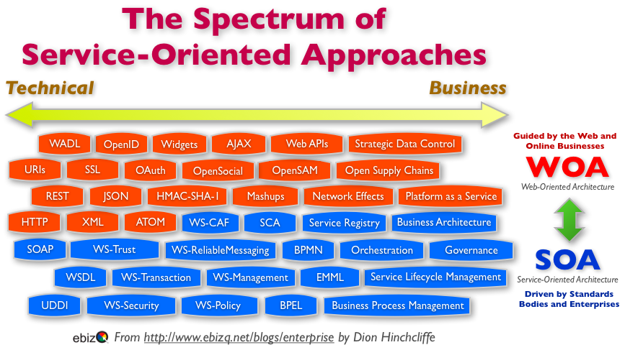
Heavyweight SOA (SOA in Enterprises)
Heavyweight SOA stacks
Driven by business processes: BPM, BPMN, BPEL, ...
Enterprise application integration (EAI)
B2B integration and SOA based portals
Unified Frameworks: SCA and WCF
Enterprise Service Bus (ESB)
SOA governance (control)
Many public standards like WS-*

Slide 12

Web Service Standards: WS-*
Service Discovery Standards
UDDI, RDDL, XRI, XRDS
Service Messaging Standards
SOAP, SOAP over JMS, MTOM, WS-Addressing
Service Meta-Data Standards
WSBPEL, WSDL, WADL, WSFL, WS-Policy, WS-PolicyAssertions, WS-PolicyAttachment, WS-MetadataExchange (WS-MEX)
Web Service Security Standards
XML-Signature, WS-SecurityPolicy, WS-Security, WS-Trust, WS-SecureConversation
Quality of Service Standards
WS-ReliableMessaging (WS-RM), WS-Coordination, WS-AtomicTransactions, WS-TX
https://www.oasis-open.org/standards

Slide 13
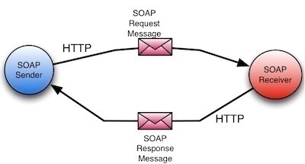
Enterprise Web Service Infrastructure
SOAP / WSDL / XML / HTTP

Slide 14
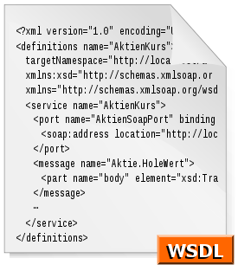


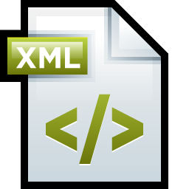

Heavyweight Web Services Infrastructure
Heavyweight (classical) Web service infrastructure components:
Description
WSDL (Web Service Definition Language)
Metadata
WS-MetadataExchange (WS-MEX), DISCO
Wire format
SOAP, XML, XSD
HTTP

Slide 15
WSDL Service Description (WSDL)
WSDL (Web Services Description Language)
Describes what a Web service can do
Names of the available methods (messages)
Input and output parameters, returned value
Data types used for parameters or result
Endpoints: ports and bindings
WSDL is an XML based, open standard from W3C

Slide 16
WSDL – Example
<?xml version="1.0" encoding="utf-8"?>
<definitions
xmlns:http="http://schemas.xmlsoap.org/wsdl/http/"
xmlns:soap="http://schemas.xmlsoap.org/wsdl/soap/"
xmlns:s="http://www.w3.org/2001/XMLSchema"
xmlns:s0="http://www.devbg.org/ws/MathService"
xmlns:soapenc="http://schemas.xmlsoap.org/soap/encoding/"
xmlns:tm="http://microsoft.com/wsdl/mime/textMatching/"
xmlns:mime="http://schemas.xmlsoap.org/wsdl/mime/"
targetNamespace="http://www.devbg.org/ws/MathService"
xmlns="http://schemas.xmlsoap.org/wsdl/">
<types> … </types>
<message name="AddSoapIn"> … </message>
<portType name="MathServiceSoap"> … </portType>
<binding name="MathServiceSoap" … > … </binding>
<service name="MathService"> … </service>
</definitions>

Slide 17
Discovery of Web Service
The process of getting the service metadata (description)
Usually a URL is interrogated to retrieve the metadata
Two protocols for interrogation
WS-MetadataExchange (WS-MEX)
Standardized protocol developed by Microsoft, Sun, SAP, …
DISCO
Old Microsoft protocol to use with the UDDI registries

Slide 18
SOAP – Request / Result Format
SOAP (Simple Object Access Protocol)
Open XML based format for sending messages
Open standard from W3C
A SOAP message consists of:
SOAP header – describes the message parameters (metadata)
SOAP body – the message data (request or response body)
Typically SOAP messages are sent over HTTP
Optionally TCP / message queue / other channels can be used

Slide 19
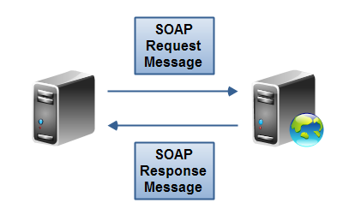
SOAP Request – Example
<?xml version="1.0" encoding="utf-8"?>
<soap:Envelope xmlns:xsi="http://www.w3.org/2001/XMLSchema-instance"
xmlns:xsd="http://www.w3.org/2001/XMLSchema"
xmlns:soap="http://schemas.xmlsoap.org/soap/envelope/">
<soap:Body>
<CalcDistance xmlns="http://www.devbg.org/Calc">
<startPoint>
<x>4</x> <y>5</y>
</startPoint>
<endPoint>
<x>7</x> <y>-3</y>
</endPoint>
</CalcDistance>
</soap:Body>
</soap:Envelope>

Slide 20
SOAP Response – Example
<?xml version="1.0" encoding="utf-8"?>
<soap:Envelope
xmlns:xsi="http://www.w3.org/2001/XMLSchema-instance"
xmlns:xsd="http://www.w3.org/2001/XMLSchema"
xmlns:soap="http://schemas.xmlsoap.org/soap/envelope/">
<soap:Body>
<CalcDistanceResponse
xmlns="http://www.devbg.org/Calc/">
<CalcDistanceResult>8.54400374531753</CalcDistanceResult>
</CalcDistanceResponse>
</soap:Body>
</soap:Envelope>

Slide 21
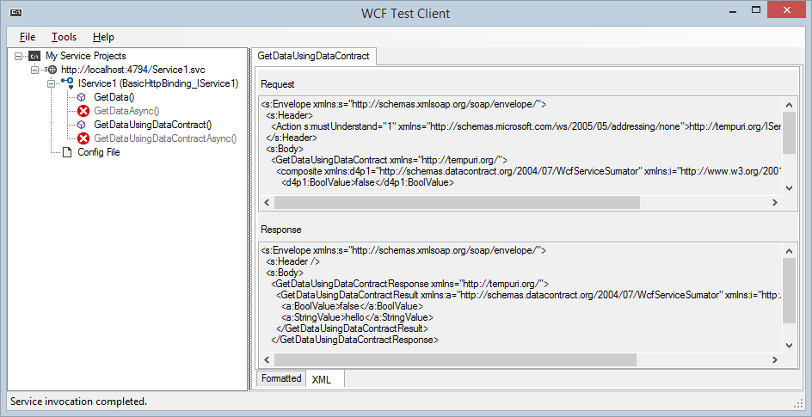
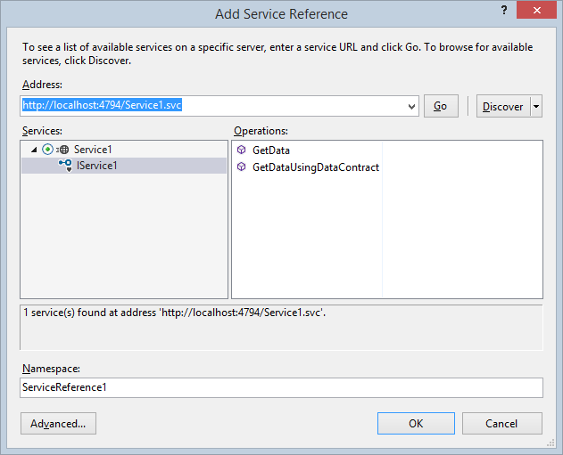
Heavyweight Web Services (Based on SOAP and WSDL)
Live Demo

Slide 22
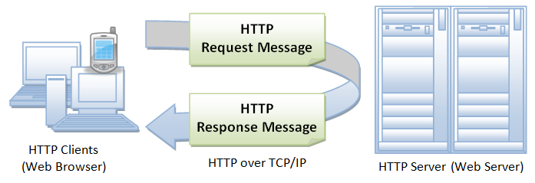


The HTTP Protocol
How HTTP Works?

Slide 23
HTTP
HTTP == Hyper Text Transfer Protocol
Client-server protocol for transferring Web resources (HTML files, images, styles, scripts, data, etc.)
The widespread protocol for Internet communication today
Request-response model (client requests, server answers)
Text-based format (human readable)
Relies on unique resource URLs
Provides resource metadata (e.g. encoding)
Stateless (cookies and Web storages can overcome this)

Slide 24


HTTP: Request-Response Protocol
Client program
Running at end host
Requests a resource
Server program
Running at the server
Provides resources
HTTP Request
HTTP Response
HTTP Client
HTTP Server

Slide 25
HTTP Conversation: Example
GET /courses/javascript HTTP/1.1
Host: www.softuni.bg
User-Agent: Mozilla/5.0
<CRLF>
HTTP request:
HTTP response:
The empty line denotes the end of the request header
HTTP/1.1 200 OK
Date: Mon, 5 Jul 2010 13:09:03 GMT
Server: Microsoft-HTTPAPI/2.0
Last-Modified: Mon, 12 Jul 2014 15:33:23 GMT
Content-Length: 54
<CRLF>
<html><title>Hello</title>
Welcome to our site</html>
The empty line denotes the end of the response header

Slide 26
HTTP Request Methods
HTTP defines request methods
Specify the action to be performed on the identified resource
Method | Description
GET | Retrieve a resource (execute query)
POST | Creates a resource
PUT | Modifies a resource
DELETE | Remove (delete) a resource
HEAD | Retrieve the resource's headers
OPTIONS | Requests communication options

Slide 27




HTTP Request Message

Slide 28
HTTP Request Message
Request message sent by a client consists of:
HTTP request line
Request method (GET / POST / PUT / DELETE / …)
Resource URI (URL)
Protocol version
HTTP request headers
Additional parameters
HTTP body – optional data, e.g. posted form fields
<method> <resource> HTTP/<version>
<headers>
(empty line)
<body>

Slide 29
HTTP GET Request – Example
Example of HTTP GET request:
HTTP request line
GET /courses/javascript HTTP/1.1
Host: www.softuni.bg
Accept: */*
Accept-Language: bg
Accept-Encoding: gzip, deflate
User-Agent: Mozilla/4.0(compatible;MSIE 6.0;Windows NT 5.0)
Connection: Keep-Alive
Cache-Control: no-cache
<CRLF>
HTTP request headers
The request body is empty

Slide 30
HTTP POST Request – Example
Example of HTTP POST request:
HTTP request line
POST /webmail/login.phtml HTTP/1.1
Host: www.abv.bg
Accept: */*
Accept-Language: bg
Accept-Encoding: gzip, deflate
User-Agent: Mozilla/4.0(compatible;MSIE 6.0; Windows NT 5.0)
Connection: Keep-Alive
Cache-Control: no-cache
Content-Length: 59
<CRLF>
username=mente&password=top*secret!
<CRLF>
HTTP request headers
The request body holds the submitted form data

Slide 31
Conditional HTTP GET – Example
Example of HTTP conditional GET request:
Fetches the resource only if it has been changed at the server
Server replies with "304 Not Modified" if the resource has not been changed
Or "200 OK" with the latest version otherwise
GET /apply HTTP/1.1
Host: www.softuni.bg
User-Agent: Gecko/20100115 Firefox/3.6
If-Modified-Since: Tue, 9 Mar 2015 11:12:23 GMT
<CRLF>

Slide 32

HTTP Response Message

Slide 33
HTTP Response Message
The response message sent by the HTTP server consists of:
HTTP response status line
Protocol version
Status code
Status phrase
Response headers
Provide meta data about the returned resource
Response body
The content of the HTTP response (data)
HTTP/<version> <status code> <status text>
<headers>
<CRLF>
<response body – the requested resource>

Slide 34
HTTP Response – Example
Example of HTTP response from the Web server:
HTTP response status line
HTTP/1.1 200 OK
Date: Fri, 17 Jul 2010 16:09:18 GMT+2
Server: Apache/2.2.14 (Linux)
Accept-Ranges: bytes
Content-Length: 84
Content-Type: text/html
<CRLF>
<html>
<head><title>Test</title></head>
<body>Test HTML page.</body>
</html>
HTTP response headers
The HTTP response body

Slide 35
HTTP Response – Example
Example of HTTP response with error result:
HTTP response status line
HTTP/1.1 404 Not Found
Date: Fri, 17 Nov 2014 16:09:18 GMT+2
Server: Apache/2.2.14 (Linux)
Connection: close
Content-Type: text/html
<CRLF>
<HTML><HEAD>
<TITLE>404 Not Found</TITLE>
</HEAD><BODY>
<H1>Not Found</H1>
The requested URL /img/logo.gif was not found on this server.<P>
<HR><ADDRESS>Apache/2.2.14 Server at Port 80</ADDRESS>
</BODY></HTML>
HTTP response headers
The HTTP response body

Slide 36
HTTP Response Codes
HTTP response code classes
1xx: informational (e.g., "100 Continue")
2xx: successful (e.g., "200 OK", "201 Created")
3xx: redirection (e.g., "304 Not Modified", "301 Moved Permanently", "302 Found")
4xx: client error (e.g., "400 Bad Request", "404 Not Found", "401 Unauthorized", "409 Conflict")
5xx: server error (e.g., "500 Internal Server Error", "503 Service Unavailable")

Slide 37
Content-Type and Content-Disposition
The Content-Type response header the server specifies how the output should be processed
Examples:
UTF-8 encoded HTML page; will be shown in the browser
Content-Type: text/html; charset=utf-8
Content-Type: application/pdf
Content-Disposition: attachment; filename="Report-April-2015.pdf"
This will download a PDF file named Financial-Report-April-2015.pdf

Slide 38
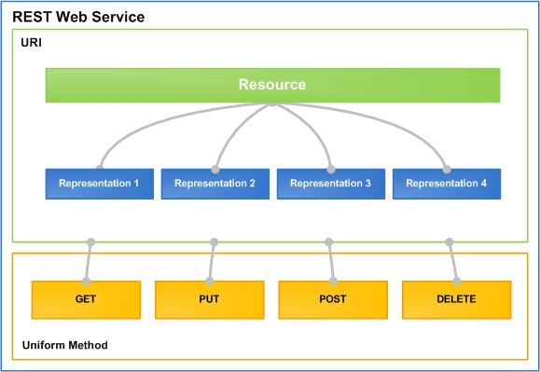
RESTful Web Services
Lightweight Architecture for Web Services

Slide 39
What is REST?
"Representational State Transfer (REST) is a software architecture style consisting of guidelines and best practices for creating scalable Web services."
http://en.wikipedia.org/wiki/Representational_State_Transfer
Application state and functionality are resources
Every resource is associated with unique URI
Each resource supports standard operations (CRUD)
This natively maps to the HTTP protocol
HTTP methods: GET, POST, PUT, DELETE, PATCH, OPTIONS, …

Slide 40
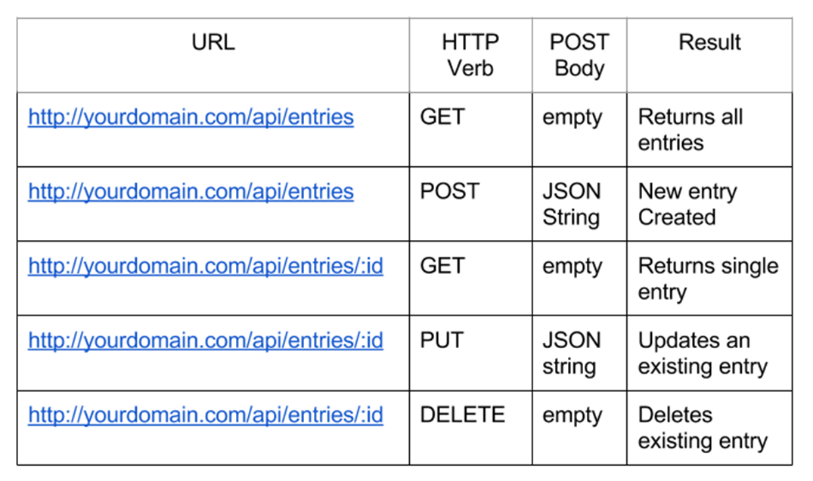
CRUD Operations in REST APIs

Slide 41
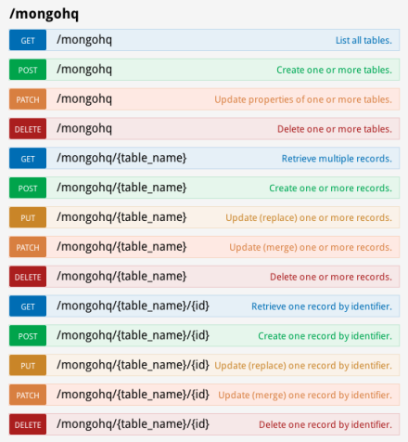
RESTful Web Services and HTTP Methods
One URI per resource
Multiple operations per URI
Get all resources / single resource by ID
GET http://myservice.com/api/Books
GET http://myservice.com/api/Books/3
Add a new resource
POST http://myservice.com/api/Books
Modify (update) a resource
PUT http://myservice.com/api/Books/3

Slide 42
RESTful Web Services and HTTP Methods (2)
Delete (remove) a resource
DELETE http://myservice.com/api/Books/3
Update resource fields (partial update)
PATCH http://myservice.com/api/Books/3
Retrieve resource meta-data
HEAD http://myservice.com/api/Books/3
Inspect resource (typically used in AJAX to request permissions)
OPTIONS http://myservice.com/api/Books/3

Slide 43
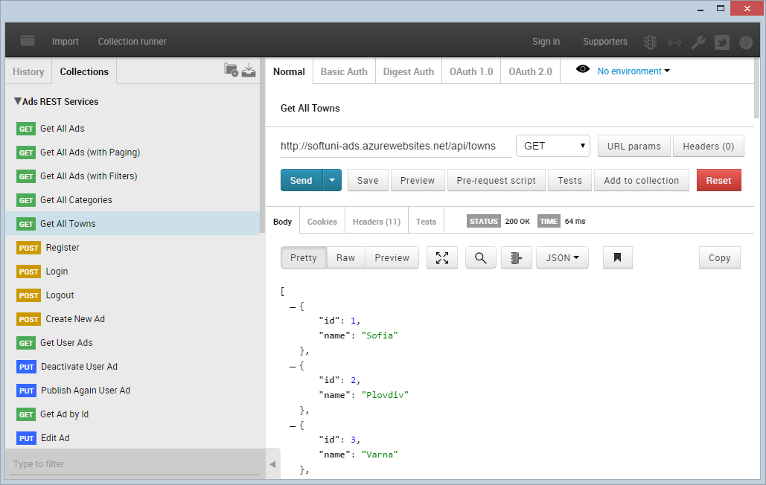
Postman – REST Client

Slide 44
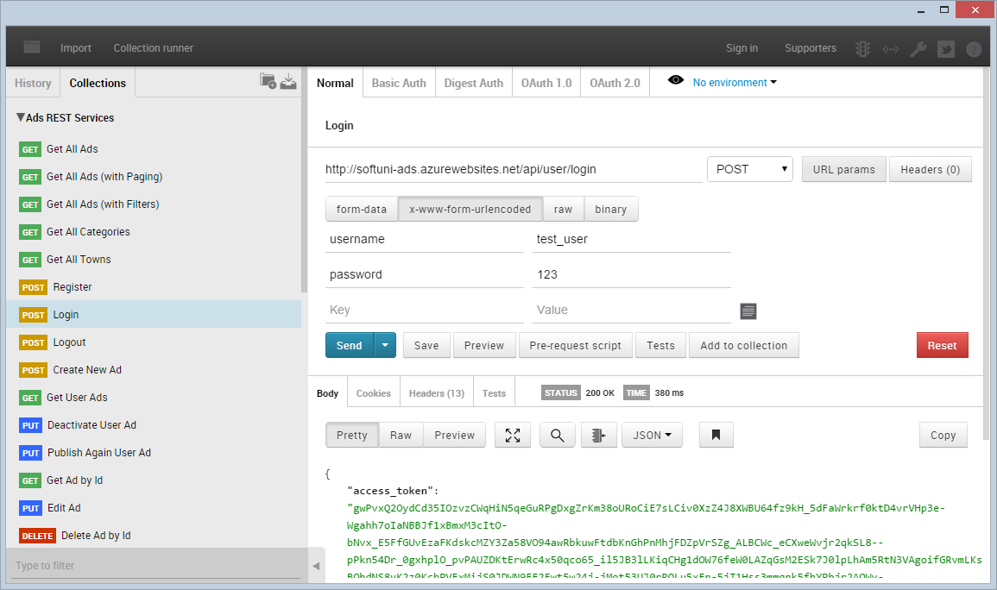
Postman
Live Demo

Slide 45
RESTful API – Example
Server
Web Client (JavaScript and jQuery)
Auth
$.post("api/register", credentials, 'json');
Register
$.post("api/login", credentials, 'json');
Login
$.getJSON("api/users");
Operations
Desktop / Mobile Client (C# / Java / PHP)
Users
Add User
var request = HttpRequest.create("api/users");
response = request.getResponse();
// Parse the response to C# objects
Remove User

Slide 46
RESTful Web Services
Live Demo

Slide 47

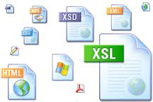

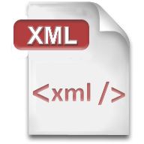


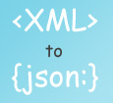

XML, JSON, RSS, Atom
Comparing the Common Service Data Formats

Slide 48

XML
XML is markup-language for data representation
Used for encoding documents in machine-readable form
Text-based format, consists of tags, attributes and content
Provide data and meta-data in the same time
<?xml version="1.0"?>
<library>
<book><title>HTML 5</title><author>Bay Ivan</author></book>
<book><title>WPF 4</title><author>Microsoft</author></book>
<book><title>WCF 4</title><author>Kaka Mara</author></book>
<book><title>UML 2.0</title><author>Bay Ali</author></book>
</library>

Slide 49
JSON
JSON (JavaScript Object Notation)
Standard for representing data structures and associative arrays
Lightweight text-based open standard
Derived from the JavaScript language
{
"firstName": "John", "lastName": "Smith", "age": 25,
"address": { "streetAddress": "17 Tintyava Str.",
"city": "Sofia", "postalCode": "1113" },
"phoneNumber": [{ "type": "home", "number": "212 555-1234"},
{ "type": "fax", "number": "646 555-4567" }]
},
{ "firstName": "Bay", "lastName": "Ivan", "age": 79 }

Slide 50

RSS / Atom
RSS (Really Simple Syndication)
Family of Web feed formats for accessing site publications
E.g. blog entries, news headlines, videos, etc.
Based on XML, with standardized XSD schema
RSS documents (feeds) are list of items
Each containing title, author, publish date, summarized text, and metadata
Atom protocol aimed to enhance RSS and allows publishing

Slide 51
RSS – Example
<?xml version="1.0" encoding="utf-8" ?>
<rss version="2.0">
<channel>
<title>W3Schools Home Page</title>
<link>http://www.w3schools.com</link>
<description>Free web building tutorials</description>
<item>
<title>RSS Tutorial</title>
<link>http://www.w3schools.com/rss</link>
<description>New RSS tutorial on W3Schools</description>
</item>
<item>
<title>XML Tutorial</title>
<link>http://www.w3schools.com/xml</link>
<description>New XML tutorial on W3Schools</description>
</item>
</channel>
</rss>

Slide 52









Web Services, SOA and REST
https://softuni.bg/courses/web-services-and-cloud/

Slide 53
License
This course (slides, examples, demos, videos, homework, etc.) is licensed under the "Creative Commons Attribution-NonCommercial-ShareAlike 4.0 International" license
Attribution: this work may contain portions from
"Web Services and Cloud" course by Telerik Academy under CC-BY-NC-SA license

Slide 54






Free Trainings @ Software University
Software University Foundation – softuni.org
Software University – High-Quality Education, Profession and Job for Software Developers
softuni.bg
Software University @ Facebook
facebook.com/SoftwareUniversity
Software University @ YouTube
youtube.com/SoftwareUniversity
Software University Forums – forum.softuni.bg

